Slide 1

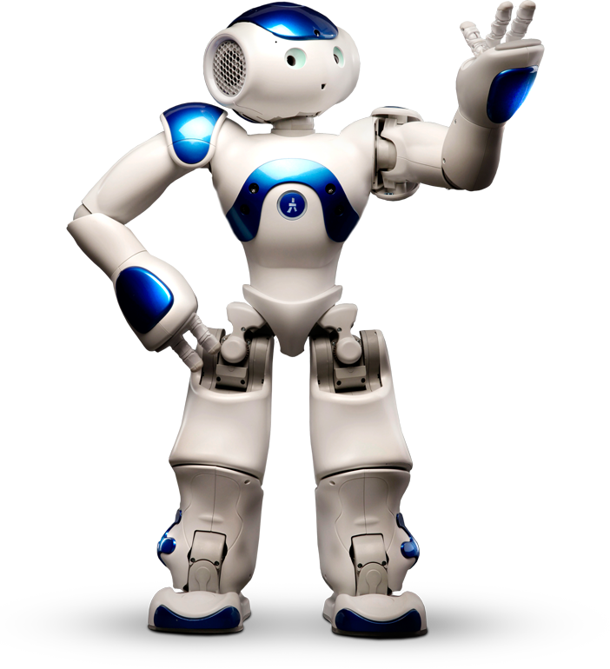
Robotics
Human-Robot Interaction
Team: Casey Chen, Hailey Dhanens, Matthew Harker,
Angie Quach, & Derek Vaughan
Client: Dr. Szilárd Vajda
Supervisor: Dr. Donald Davendra
January 31, 2019

Slide 2
Table of Contents
1
Recap from Last Quarter
NAO’s Past, Present, & Future Capabilities
Coding with NAO (Choregraphe, etc.)
Problems/Issues Thus Far
Remaining Project Schedule
Tech Demo

Slide 3

Recap:
2
What is NAO?
Our Goal: Showcase meaningful human-robot interaction using the Aldebaran NAO robots acquired by CWU.
Our Roles: Slight changes to original team structure such that everyone can more effectively contribute.

Slide 4

3
Past, Present, & The Future!

Slide 5
NAO’s Initial Capabilities
4
Basic information about its onboard systems
Simple responses (e.g. “Hello”)
Few movement options
Various language options

Slide 6
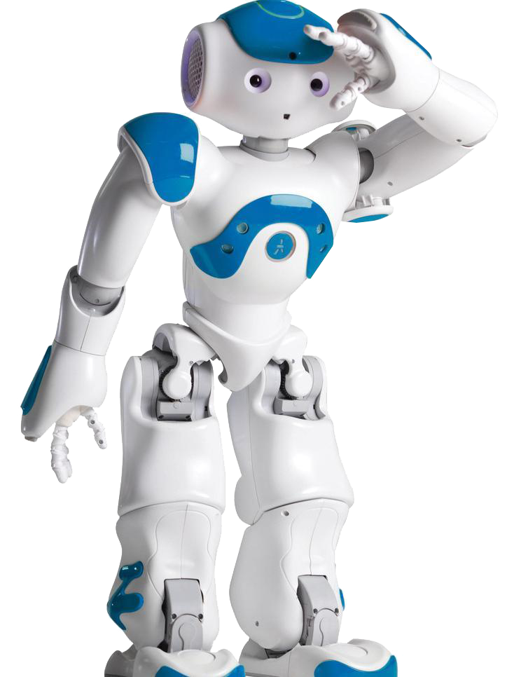
What is NAO Currently Capable Of?
5
Expanded pool of verbal responses
Advanced movement options
Facial recognition of AriGato team members
Small “easter eggs” (e.g. Jazz Hands)

Slide 7

What’s Next for NAO?
6
Furthering its movements & verbal responses (parsing parameters)
Playing small games and dances
Advancing facial recognition features
Emotions (recognition & response)

Slide 8

7
Coding with
NAO

Slide 9
Steps for Creating a NAO module:
8
Create a new Python “box” in a Choregraphe workbench
By default, 5 new functions will be created
_init_, onLoad, onUnload, onInput_onStart, onInput_onStop
Write new Python script in the “onInput_onStart” function.
Simply press “Play”!

Slide 10
Steps for Creating a NAO module (cont.):
9
Module will either be ran on a simulated NAO robot, or a physical robot connected via Ethernet.
The project properties menu allows us to set trigger and response phrases.
Installing a module to NAO is as simple as pressing “Install to robot” in Choregraphe while NAO is connected.

Slide 11
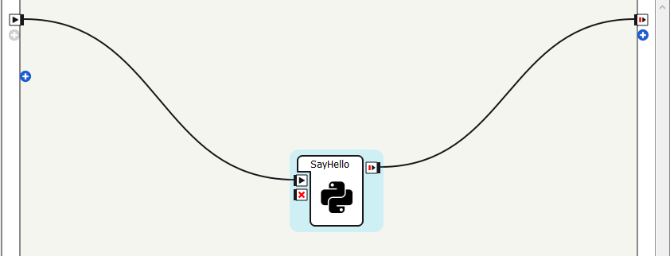
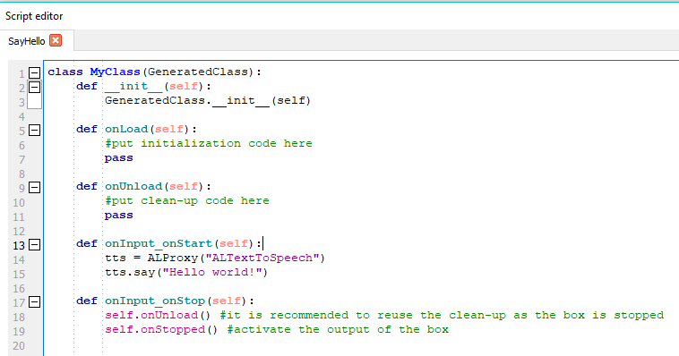
10
Python “Box”
Basic text-to-speech script

Slide 12

11
Problems
Encountered

Slide 13
Problems & Solutions
12
Choregraphe Installation Issues
Infinite Loops
“How old are you?” module
Suppressed other behaviors
Recognizing parameters from voice commands
Notes:
Infinite loops:
-angie’s 30 minute national anthem module
-derek’s left foot module
-angie’s face recognition module

Slide 14

13
Remaining
Project Schedule

Slide 15
Plans Through the Rest of the Quarter...
14
Finish up Functional Requirements ASAP
Start usability testing with students and faculty
Begin Escalation Phase for Non-Functional Requirements
Scrum meetings 1-2x a week to discuss new
modules, progress & testing
Final presentation

Slide 16
15
Tech Demo
[Video here]

Slide 17
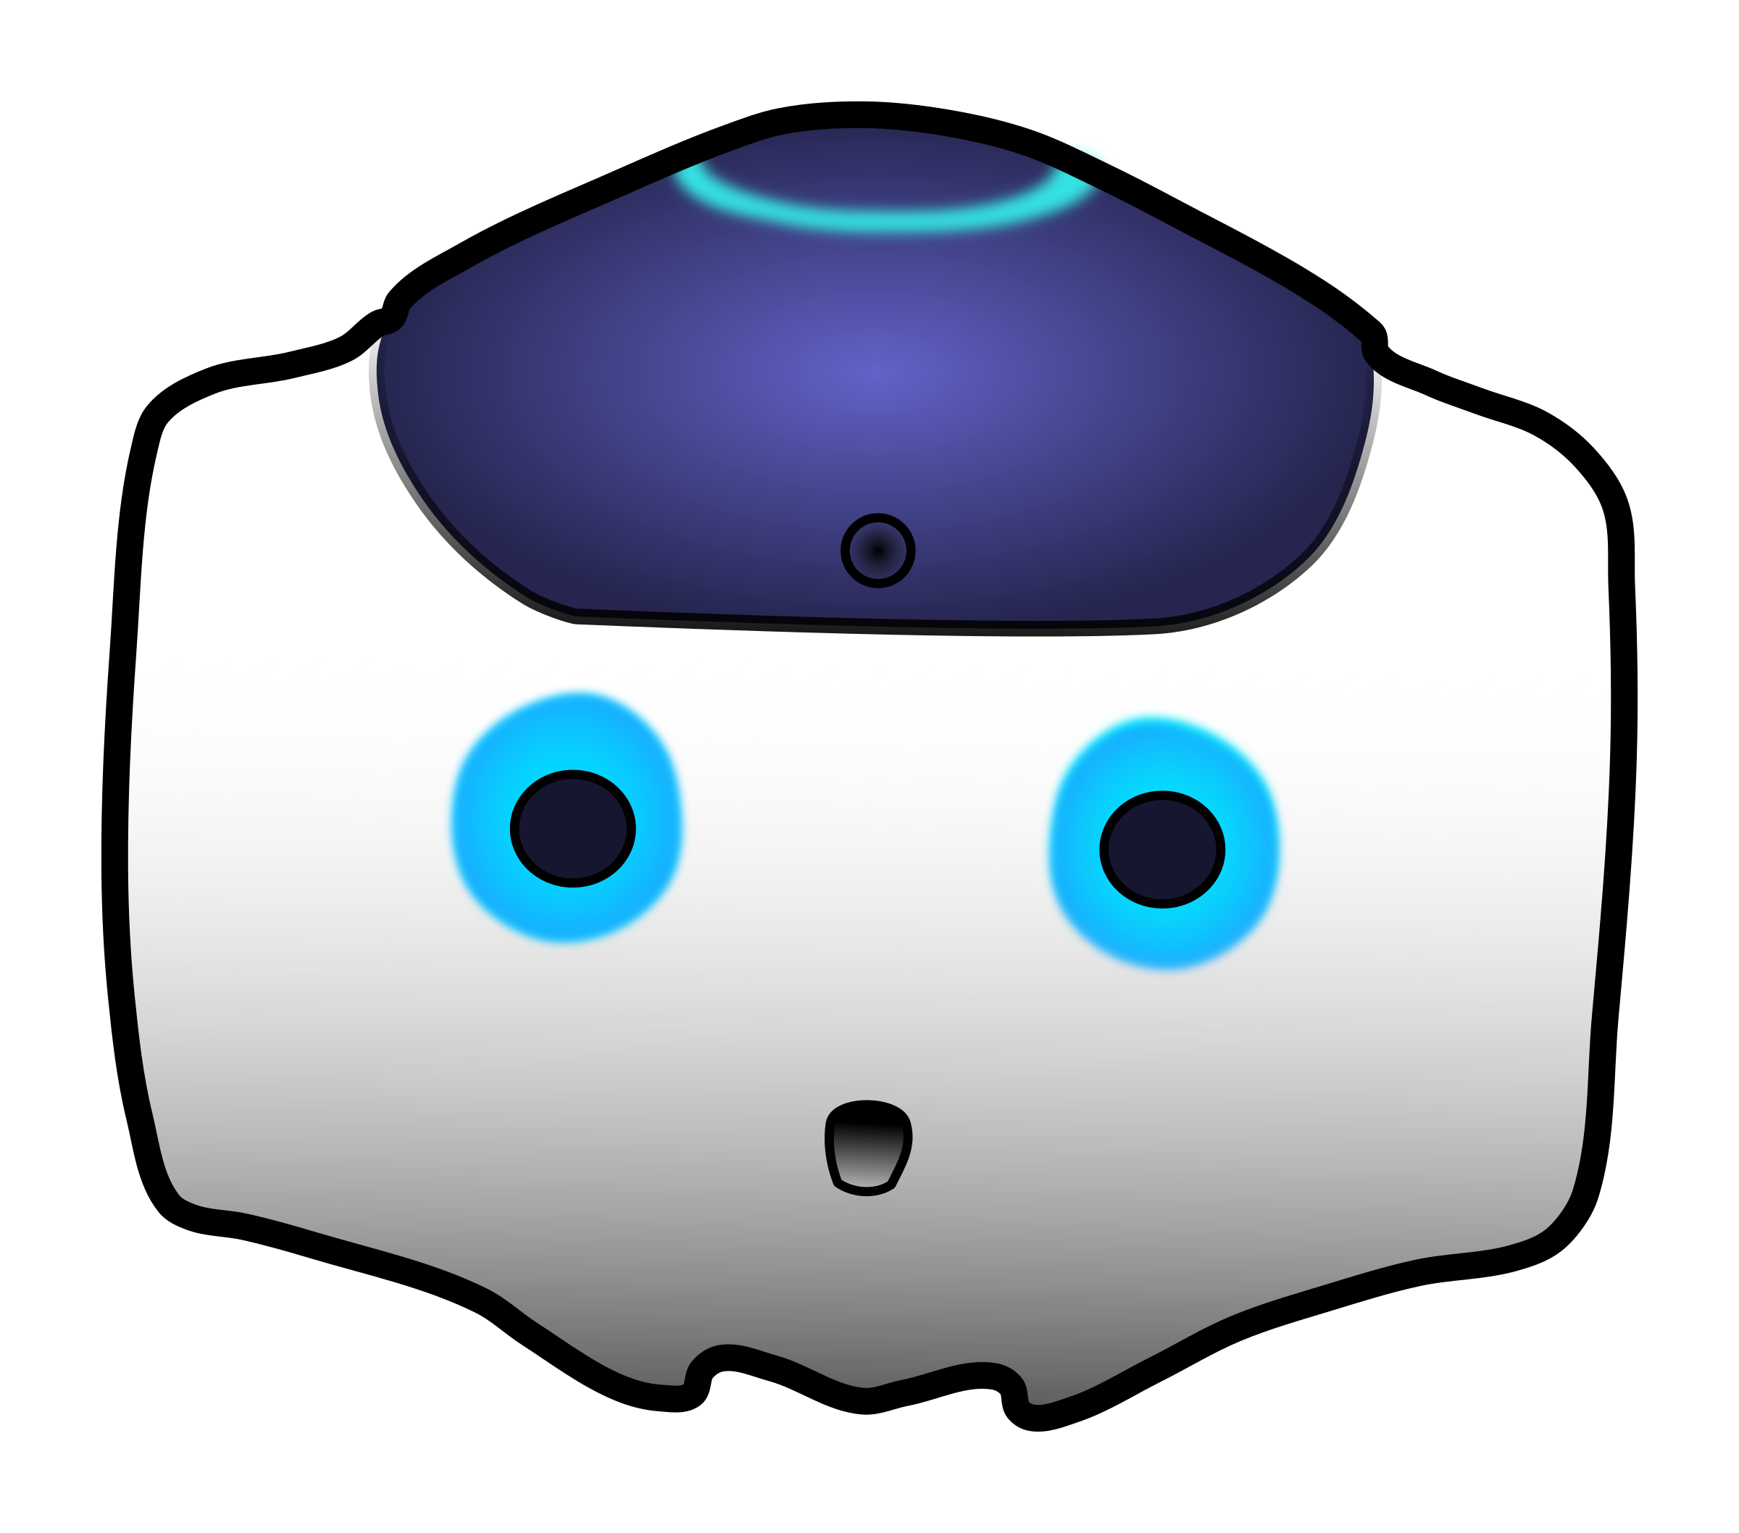
16
Thank You!
Questions?

